Slide 1





`

Slide 2
`
Adam Grinold │Executive Director
Brattleboro Development Credit Corporation
76 Cotton Mill Hill | Brattleboro VT 05301
802 257 7731 ext. 224 Office | 802.257.0294
Fax 802 780 7828 Mobile
brattleborodevelopment.com
seveds.com

Slide 3
Community Development Block Grant –
Disaster Relief
BDCC and SRDC received funding via a Community Development Block Grant specific to Disaster Recovery from the Vermont Agency of Commerce and Community Development to assist businesses with “unmet disaster recovery needs” related to Tropical Storm Irene which impacted the region in 2011. At the time, there was $8M in unmet need documented between Windham, Bennington and Windsor Counties.
2012-2016

Slide 4
Strengthening Southern Vermont
Background: Working with the Windham and Bennington Regional Planning Commissions, BDCC led development of a disaster recovery grant funded project for business assistance.
There were three parts to Windham/Bennington flood recovery project: Village and Downtown Revitalization, the Flood Recovery Officer program and the Southern Vermont Sustainable Marketing Program (SVSMP).
2013-14

Slide 5

2014

Slide 6
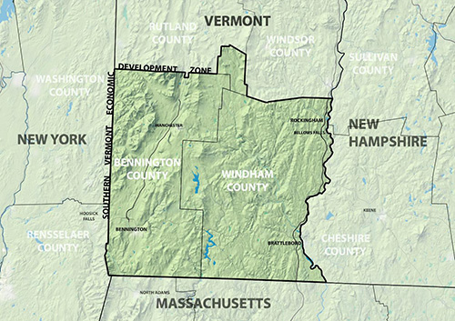

Southern Vermont Zone &
Southern Vermont Economy Project
2015-2017

Slide 7
Big Reasons Why Joint CEDS
Multi county CEDS are the norm
  they often just work by delegates and lose the grassroots.
  They often are not built to be implemented
Windham CEDS was an exception allowed due to
  Nuclear power plant
  Natural disaster
  EDA suggested joint CEDS in response to Zone creation

Slide 8
Laura Sibilia
Director of Regional Economic Development Strategies and Programs
Brattleboro Development Credit Corporation
76 Cotton Mill Hill
Brattleboro, VT 05301
www.SeVEDS.com
www.brattleborodevelopment.com
work 802-257-7731
cell 802-384-0233

Slide 9
SeVEDS
Started in 2007 as a small group looking to improve broadband and cell service
After many meetings it became painfully clear that the region’s problem wasn’t lack of broadband, it was lack of economic development
Assistance was offered by Fairpoint Communication and their contractor Vital Economies
Over 2 ½ years the SeVEDS organization solidified with a Board of Directors, and contracted staff from BDCC

Slide 10
KEY=SeVEDS Regional Board and Private Sector Leadership
Retired | 2016
Bennington County Regional Commission | 2016
Vermont Geeks | 2016
New Chapter, Inc | 2016
Town of Brattleboro | 2016
Stratton Mountain Resort | 2015
Windham Regional Commission | 2015
Chroma Technology | 2015
Town of Putney | 2015
Richards Insurance | 2015
Bartleby's Books | 2015
Strolling of the Heifers | 2014
Brattleboro Development and Credit Corp | 2014
Stevens & Associates | 2014
Marlboro College | 2014
Brattleboro Retreat | 2014
Mount Snow Valley Chamber of Commerce | 2014
Town of Rockingham Village of Bellows Falls | 2014

Slide 11
SeVEDS Original Mission and Vision
Mission:
SeVEDS exists to reverse the economic decline of our region.
Vision:
Southeastern Vermont will have an economy
that generates long-term growth and prosperity and that improves our quality of life and sustains our quality of place.

Slide 12
Regional Data
Drove our strategy development and decision making

Slide 13
SeVEDS Regional Data – Population
In the 2010 Census, Maine and Vermont ranked #1 and #2 as the oldest states. and Windham County is aging faster than Maine and Vermont.
Significant increase in the population of those people approaching retirement age
Age groups entering the working population (late teens and early twenties) are small
Significant decrease in prime workforce and childbearing ages
Continual decline in the number of school-aged children since 1990’s

Slide 14
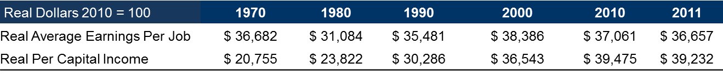
SeVEDS Regional Data – Wage Stagnation
From 1970 to 2011, Average Earning per Job fell from $36,682 to $36,657, in real terms, a drop of $25
From 1970 to 2011, Per Capita Income grew from $20,755 to $39,232, in real terms, an 89% increase

Slide 15
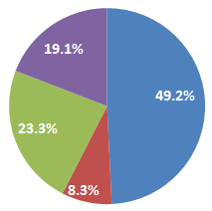
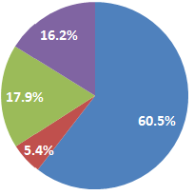
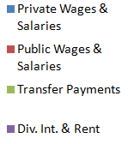
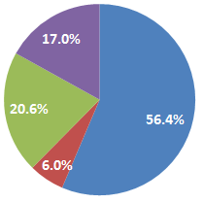
Div. Int. & Rent declined by
1.5% since 2009
1.1% Improvement since 2009
Windham 2011
US 2011
Transfer payments rose by .4 % from 2009
VT 2011
Windham County still lags behind the US and Vermont in percentage of Private Sector Earned Income.
Significantly higher proportion of income from Transfer Payments
Significantly higher share of income received from Dividends, Interest & Rents
Sources of Personal Income (2011)
Source: BEA 2009 & VE Analysis

Slide 16
Who developed the Windham Region CEDS?
Southeastern Vermont Economic Development Strategy
Business and Industry
27 Municipalities
Brattleboro Development Credit Corporation
Windham Regional Commission
Non profit Organizations
Residents

Slide 17
What has SeVEDS Done so far?
Engaged the public and private sector
Post Vermont Yankee Task Force
CEDS Development
Municipal $$ Workforce Development
Six Colleges Collaborative/Internship program
Cluster analysis

Slide 18
SeVEDS Post VY Task Force
Former Speaker of the House Chaired Committee
Produced “Windham County Post VY Economic Mitigation and Growth Report” in 2012

Slide 19
SeVEDS Board and Committee Engagement from 2011 - 2014
55+ SeVEDS Regional Board meetings
8 Post VY Task Force meetings
25 Workforce Committee meetings
10 CEDS Committee meetings
10 Accelerator meetings
10 Green/Sustainable Building Cluster meetings

Slide 20


Slide 21
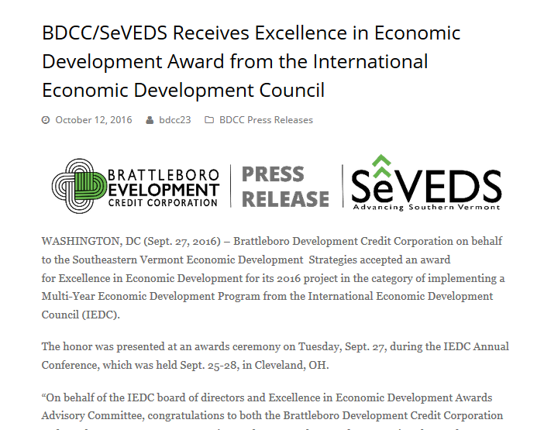

From 2013 to 2014, Windham County led growth within the tristate region at an increase of 450 jobs (1.4%).
The county’s GDP also saw an increase from 2012 to 2013 in the amount of 5.3% (GDP 2012: $2,512,271,397, GDP 2013: $2,645,945,662 Change: 133,674,265 Growth: 5.3%).
We are beginning to see positive economic effects from implementation of the CEDS.

Slide 22
Bill Colvin │Acting Director, Bennington County Industrial Corporation
Assistant Director, Bennington County Regional Commission
111 South St, Suite 203 | Bennington VT 05201
802 442 0713 ext. 1
bcrcvt.org
bcic.org

Slide 23
Southern Vermont Economic Development Zone
Created by Vermont General Assembly – 2015
44 towns – BDCC & BCRC
9 Member Committee
  Gubernatorial Appointee – Wayne Granquist (Chair)
  2 House – Lisa Sullivan, Michael Keane
  2 Senate – Tom Cain, Dr. Mariko Silver
  RDC’s – Adam Grinold, Peter Odierna
  RPC’s – Chris Campany, Bill Colvin
Report due December 1, 2015
Report supplement issued July 7, 2016

Slide 24
Southern Vermont EDZ Development Zone - FINDINGS
Shrinking Population
down 3.5% by 2030 (Rest of VT – down by 0.5%)
Aging Population
30% of population over 65 by 2030
(2010 Census – 17.6%)
Jobs Unfilled, Yet People Looking
VT Job Link in 2016: 7,529 Job Listings – 3,057 Job Seekers
Tourism Revenues Rebounding More Slowly Than Northern VT
Rooms & Meals Tax Receipts (No VT: +37%; So VT: +11%)
Retail Sales (No VT: +4%; So VT: -11%)

Slide 25
Southern Vermont Economic Development Zone - RECS
Spur business development in the Zone through an integrated strategy.
  Create Southern Vermont CEDS – build off Windham Region/SeVEDS
Implement the Southern Vermont Sustainable Recruitment and Marketing Program.
Integrate workforce education, internship and career development programs.
Create a private-public partnership to attract investment capital to the Zone
Define the role of the Zone Committee and/or other groups in continuing the work and its mission.

Slide 26
Southern Vermont Economic Development Zone - Legislation
2016: Economic Development Planning funding for BCRC
Conduct inventory of critical assets
Form EDA-consistent Steering Committee to guide economic development work
Educate Committee members, private sector, and town officials on CEDS process and requirements
Build public support for process
Co-host Southern Vermont Economic Development Summit with partners from the Windham County region.

Slide 27
Jonathan Cooper │Community & Economic Development Specialist
Bennington County Regional Commission
111 South St, Suite 203 | Bennington VT 05201
802 442 0713 ext. 312
bcrcvt.org
bcic.org

Slide 28
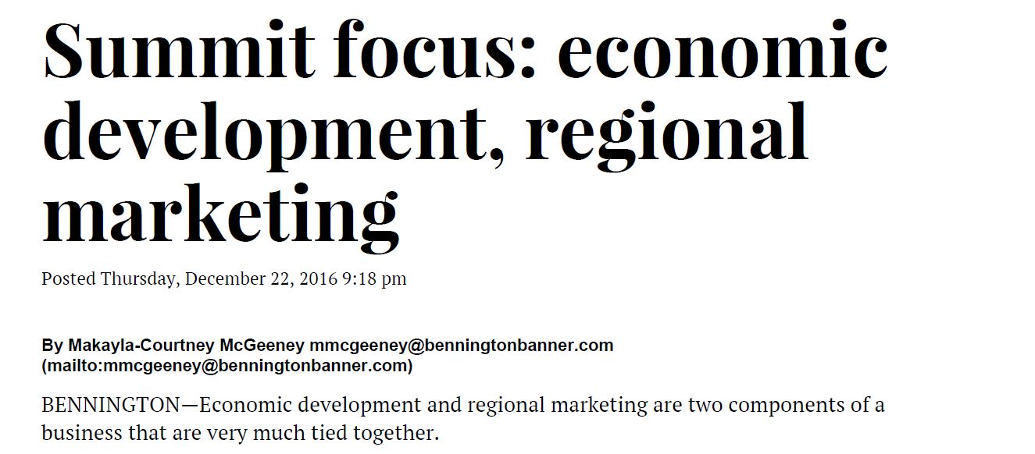
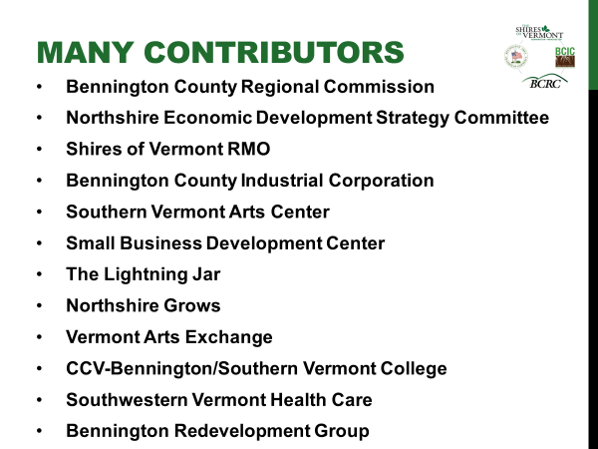
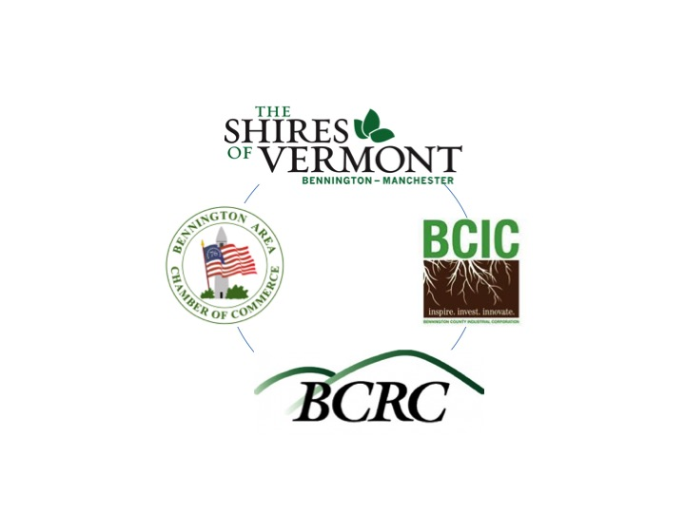
Fall 2016: Common Conversations
Notes:
Jon to work on; send to Matt by Tuesday

Slide 29
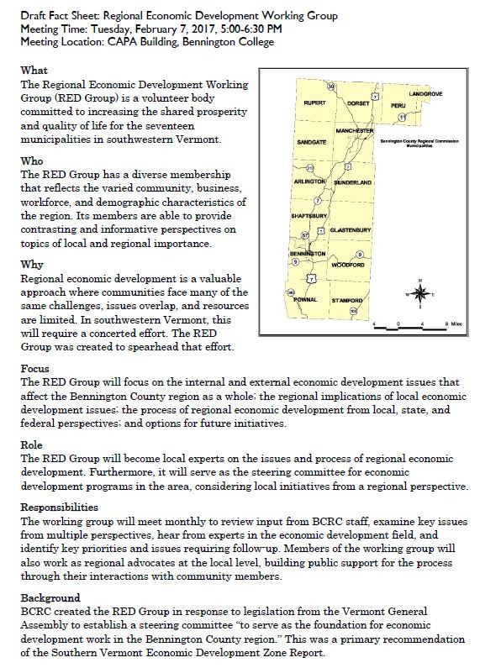
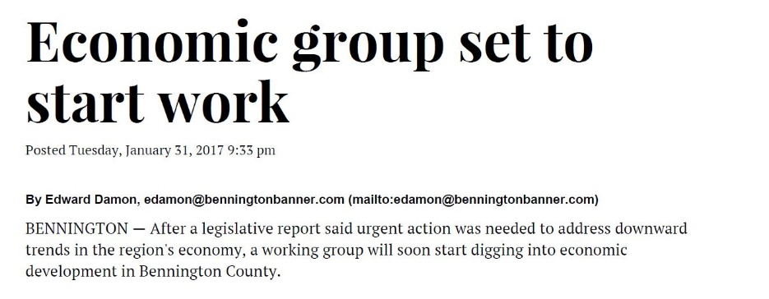
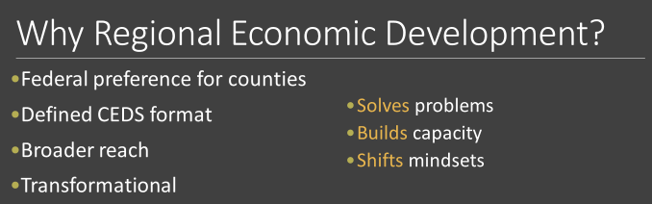
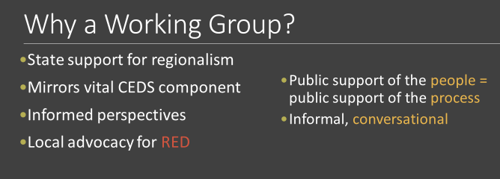
Winter 2017: The RED Group

Slide 30
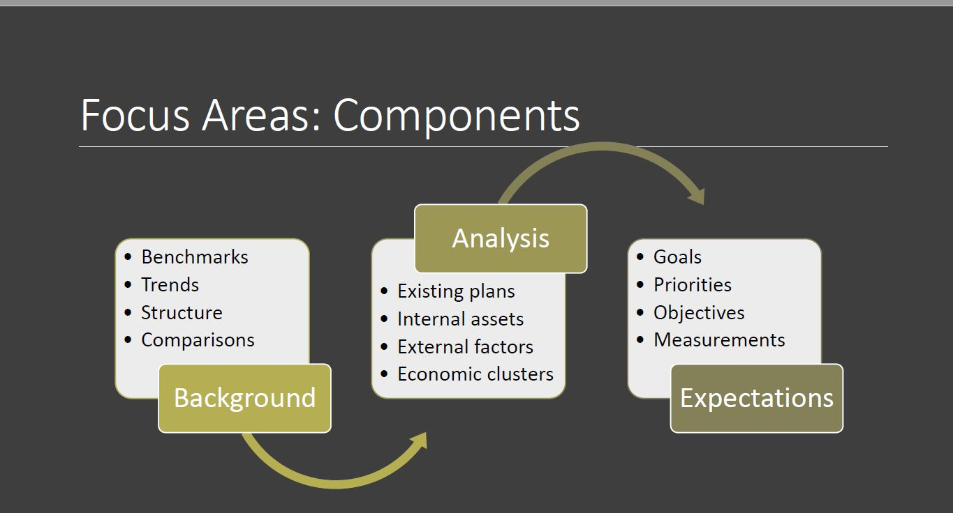
Winter 2017: The RED Group

Slide 31
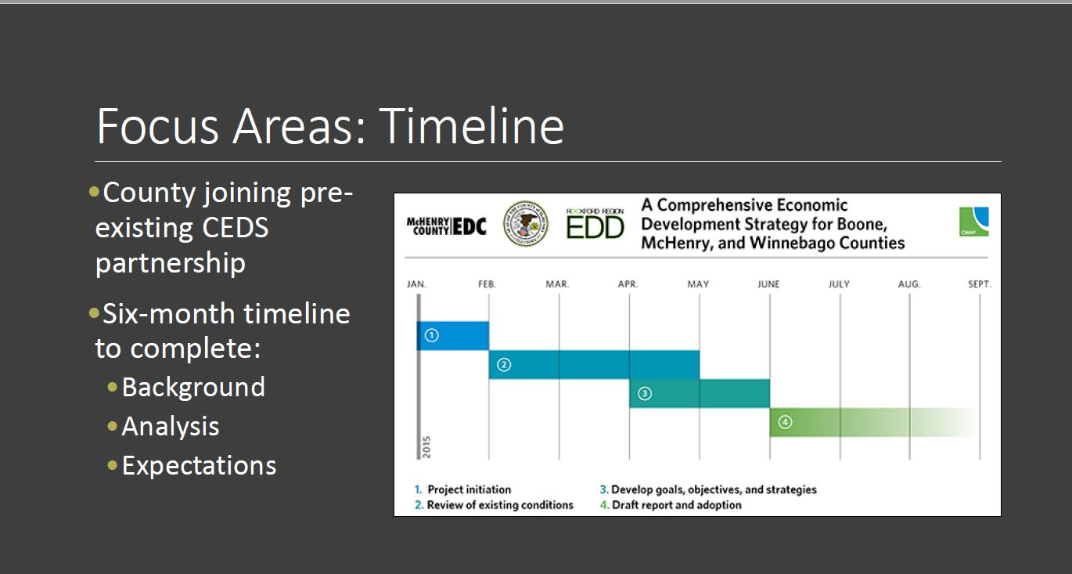
Winter 2017: The RED Group

Slide 32
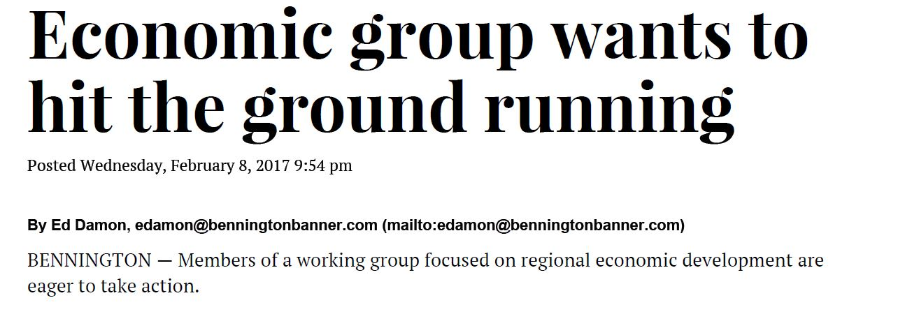
Winter 2017: The RED Group

Slide 33
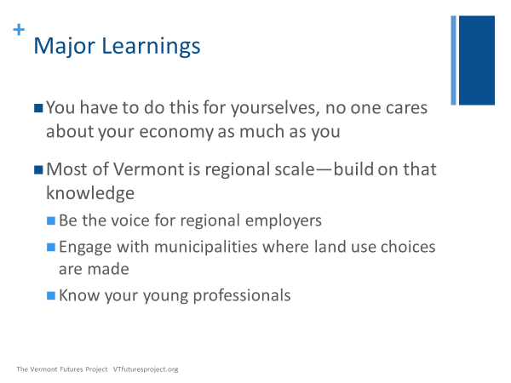
Winter 2017: The RED Group

Slide 34
Spring 2017: the Joint Proposal
Goal: A CEDS for Southern Vermont.
Geography: Southern Vermont Economic Development Zone.
Framework: S.M.A.R.T. criteria for accountability and regional impact.
Deliverable: Engaging document for the general public.
Application: BDCC as applicant, BCRC as a sub-recipient.
Steering Committees: The RED Group and SeVEDS will devise strategies in sub-regions, and recommend local projects to Joint Board.
Joint Board: Meets 4-6 times per year to review progress, evaluate strategies, prioritize funding applications, etc.

Slide 35
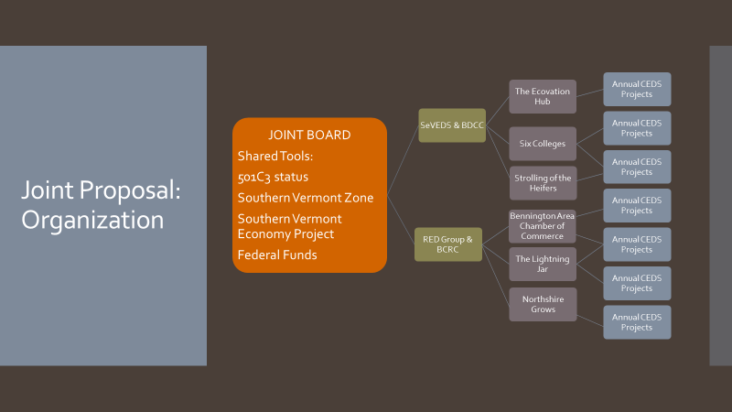
Spring 2017: the Joint Proposal

Slide 36


Slide 37
